Slide 1


Join us for
10 February 2026
eSafety.gov.au/SID
Notes:
Hello and welcome everyone to our Safer Internet Day presentation created by the eSafety Commissioner.

Slide 2



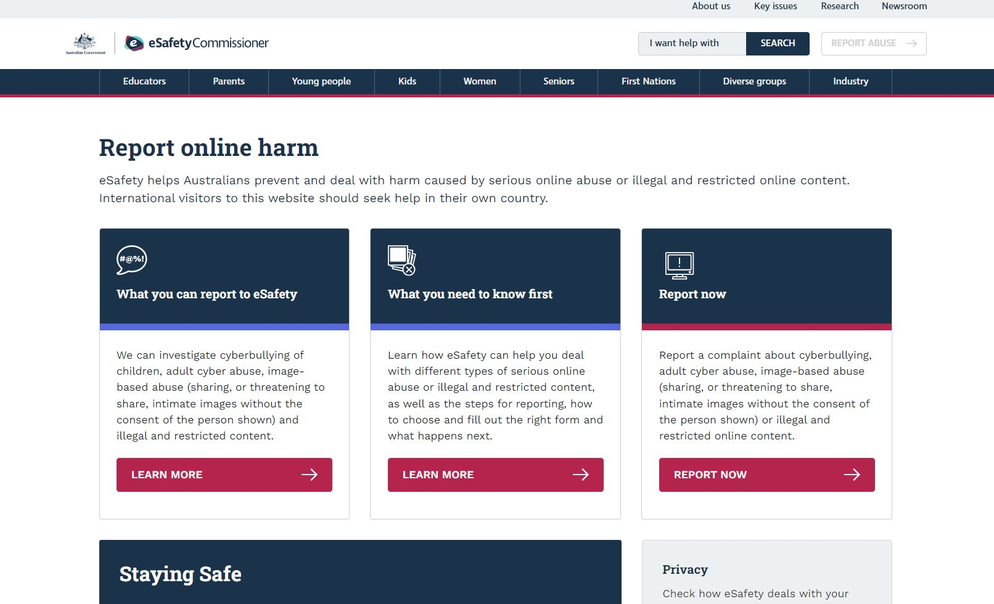
Australia’s independent regulator for online safety
Provide evidence based resources and programs
Help remove harmful content
Keep tech companies accountable
Notes:
The eSafety Commissioner (eSafety) is Australia’s independent regulator and educator for online safety – the first in the world. Their purpose is to help safeguard all Australians from online harms and to promote safer, more positive online experiences through:
educating people about online safety risks, how to be safe online, and where to go for help through programs and resources
helping remove harmful content such as cyberbullying of children and young people, adult cyber abuse, revenge porn or image-based abuse, and illegal and restricted content through their regulatory schemes
identifying emerging risks and ensuring tech companies minimise harm.

Slide 3

What is Safer Internet Day?
Global day of action celebrated in 180 countries to raise awareness of online safety and the need to adapt our online safety practices to the ever-evolving digital landscape.
eSafety leads the day in Australia.
eSafety is calling on all Australians to help make the internet a safer, more positive place.
Notes:
Safer Internet Day is a global day of action bringing communities, schools, organisations and families from more than 180 countries together to raise awareness of online safety issues and work toward a safer internet. The eSafety Commissioner leads the day in Australia.
Safer Internet Day is a national moment to kickstart the year with an online safety focus – bringing online safety into every workplace and home.
Everyone can take practical steps, including engaging in online safety education, practicing respectful behaviour online, reporting online abuse and sharing online safety resources with others.
We all have a role to play in fostering safer online spaces by being kind, respectful, and addressing harmful content when we see it.

Slide 4



Why is Safer Internet Day
so important?
We live so much of our lives online - at school, at work, and at home. The internet offers incredible opportunities, but it also exposes us to real risks like abuse, misinformation and exploitation. As online safety becomes a national priority, with growing conversations around age restrictions and digital wellbeing, Safer Internet Day is our moment to work towards a safer, more positive internet.

Slide 5






Five tips for a safer internet
Balance time online
Protect your space
Start the conversation
Be kind
Speak up
01
02
03
04
05
Notes:
So, to help make a difference, here are five simple ways that can help you contribute to a safer, more positive internet. Share these important online safety messages with your colleagues, customers, family and friends. ​

Slide 6



01
02
Be kind
03
Practice respect, empathy and kindness.
While it might sound basic, this is the behaviour we need to counteract the negativity we can see online.
Being kind online doesn’t just make individual interactions better; it contributes to a larger cultural shift that makes the internet a safer, more positive place for everyone.
04
05
Notes:
Tip 1 – Be kind: practice respect, empathy and kindness. ​
​
While it might sound basic, this is the behaviour we need to counteract the negativity we can see online. ​
​
Being kind online doesn’t just make individual interactions better; it contributes to a larger cultural shift that makes the internet a safer, more positive place for everyone. ​
​

Slide 7


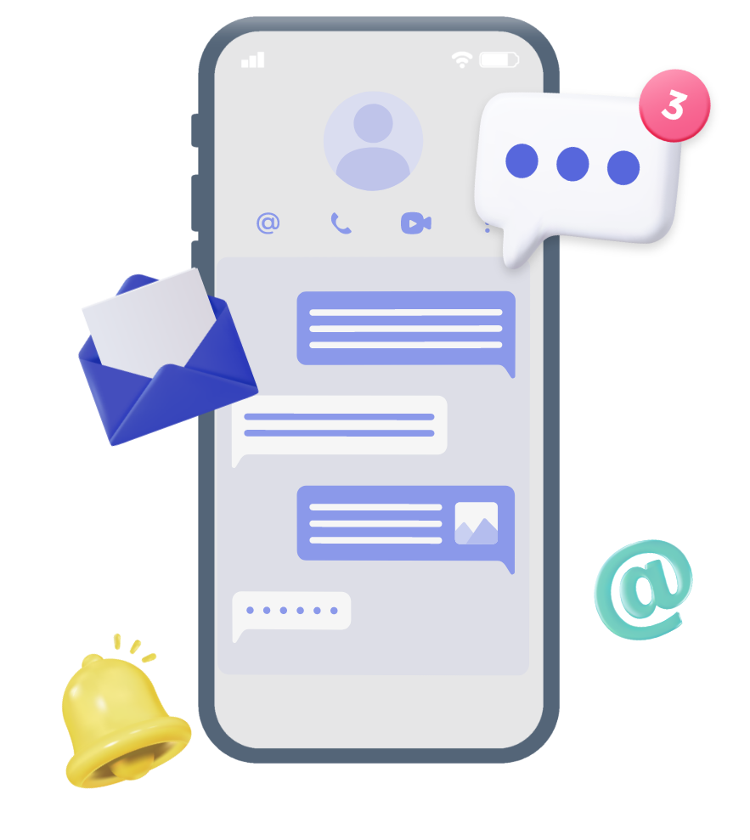
01
02
Balance time online
03
Make space for offline connection, rest and reflection.
04
Spending too much time online can affect you in real life and your relationships. Ensure to make space for offline connection, rest and reflection to fully live in the moment.
05
Notes:
Tip 2 – Balance your time online and be conscious of the content you consume and share
Make space for offline connection, rest andreflection.
Spending too much time online canaffect you in real life and yourrelationships. Ensure to make space foroffline connection, rest and reflection tofully live in the moment.

Slide 8



01
Speak up
02
Report online abuse and harmful content.
eSafety helps Australians prevent and deal with harm caused by serious online abuse or illegal and restricted content.
Collect evidence and then report the harmful material to the platform, and eSafety. Depending on the situation, you can also report it to police. In the most serious cases, when the platform does not help, eSafety can intervene.
03
04
05
eSafety.gov.au/report
Notes:
Tip 3 – Speak up - Report online abuse and harmful content
eSafety helps Australians prevent and deal with harm caused by serious online abuse or illegal and restricted content.
Collect evidence and then report the harmful material to the platform, and eSafety. Depending on the situation, you can also report it to police. In the most serious cases, when the platform does not help, eSafety can intervene.

Slide 9






01
Protect your space
02
Take steps to keep your online accounts and devices secure. Use strong, unique passwords, turn on multi-factor authentication, and keep your software up to date. Be mindful of what you share and help others learn these practices too.
03
04
04
05
Protecting your space reduces the risk of scams, hacks, and data breaches. When you stay secure, you help build a safer, more supportive online community.
Notes:
Tip 4 – Protect your space
Take steps to keep your online accounts and devices secure. Use strong, unique passwords, turn on multi-factor authentication, and keep your software up to date. Be mindful of what you share and help others learn these practices too.
Protecting your space reduces the risk of scams, hacks, and data breaches. When you stay secure, you help build a safer, more supportive online community.

Slide 10

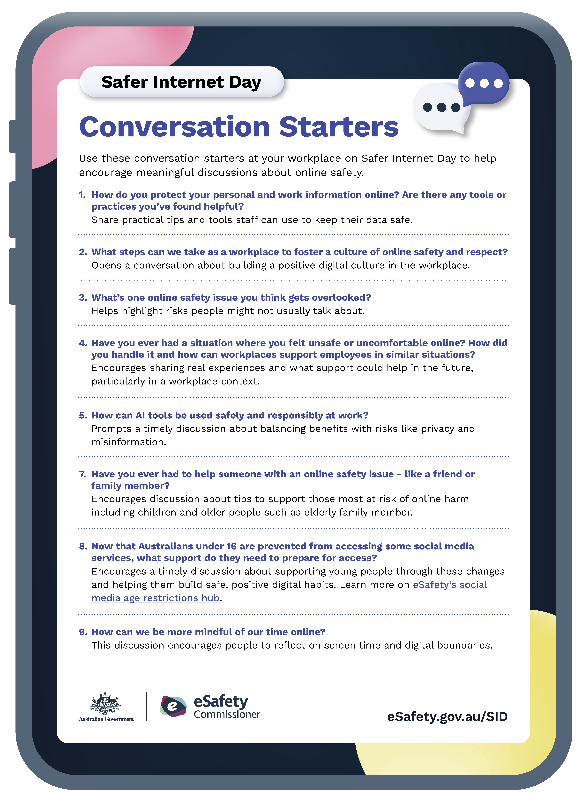
01
02
Start the conversation
Engage in discussions about online safety with your networks and communities, family, friends and colleagues.
03
It’s never too early or too late to start talking about online safety. Having these conversations raises awareness of risks and responsibilities, builds support and fosters a collective commitment to a safer, more positive online environment.
04
05
Use our conversation starters in the Safer Internet Day resources to get started.
Notes:
Tip 5 – Start the conversation
Engage in discussions about online safety with your networks and communities, family, friends and colleagues.
It’s never too early or too late to start talking about online safety. Having these conversations raises awareness of risks and responsibilities, builds support and fosters a collective commitment to a safer, more positive online environment.

Slide 11




Support Safer Internet Day 2026
Download the resources and promote the assets to your community.
Use eSafety’s Quiz to test your online safety knowledge.
Support Safer Internet Day on social using #SID2026 and #SaferInternet [Tag@eSafety so we can share your post too] Day.
Register for eSafety’s
parent and carer webinar, including one on the updates to social media access for under 16s.
Use the eSafety Zoom or Teams background at work.
eSafety.gov.au/SID
Notes:
To wrap up, here are eSafety’s top suggestions to get involved in Safer Internet Day:
Download the resources and promote the assets to your community.
Support Safer Internet Day on social using #SID2026 and #SaferInternet Day [Tag @eSafetyOffice so we can share your post too]
Use eSafety’s Quiz to test your online safety knowledge
Register for eSafety's parent and carer webinar and invite three people you know
Use the eSafety Zoom or Teams background at work
Find everything you need at eSafety.gov.au/SID.

Slide 12

Help make the internet a safer, more positive place.
eSafety.gov.au/SID
Notes:
Thank you!
If you want to know more about eSafety and how you can priotise online safety at your workplace, visit eSafety.gov.au

